Slide 1
Welcome to the Research and Innovation Roadmap
Conversation Lounge!
Today’s agenda: Welcome, presentation for 15-20 minutes, open discussion.
For the discussion, we will utilize Chat in Zoom (not in the Pathable website). We will be monitoring the chat and respond as we can. You can also use the “Raise Hand” feature and we will call on folks.
Please be respectful in your interactions and follow the SAA Code of Conduct: http://www.archivists.org/statements/saa-code-of-conduct
This session will not be recorded.
Committee on Research, Data and Assessment (CORDA)

Slide 2
SAA Research & Innovation Roadmap
https://www2.archivists.org/groups/committee-on-research-data-and-assessment/saa-research-and-innovation-roadmap-beta-version-10
An analysis of current and emerging research, assessment & data needs, to frame & inform work the profession might undertake in the future.
Notes:
The SAA Research and Innovation Roadmap is an active and evolving document and asserts the critical research needs and gaps that have been identified by members across the profession. The roadmap reflects an analysis of current and emerging research, assessment, and data needs, to frame and inform work the profession might undertake in the years to come. The roadmap has been inclusively developed, and yet is necessarily bound by time and place. To address inclusivity, the design of the document is flexible to allow for continued contributions, and to position it as representative of professional needs and priorities. Initial goals, topics, and themes of interest to SAA and the archival profession were identified during interviews that Task Force on Research/Data and Evaluation conducted for the purpose of persona needs analysis in 2017-2018, and from key literature sources concerning archival research. Select examples of past research, existing resources, and standards and guidelines for collecting data are annotated in this document. The roadmap further incorporates priority areas identified by the SAA 2020-2022 strategic plan and 2020-2021 DEIA plan. CORDA plans to gather further commentary and perspectives from SAA Section and Committee chairs and SAA members through a period of open feedback this year. Please watch for invitations to be involved as it is crucial that SAA leadership helps us shape the roadmap.

Slide 3
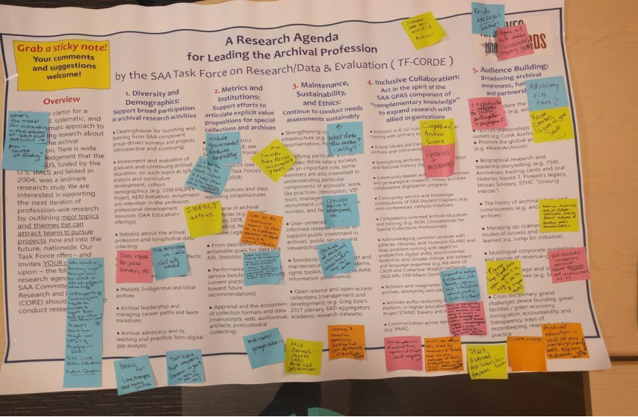

Slide 4
Research and Innovation Roadmap: Themes
Demographics
Diversity and Inclusion
Inclusive Collaboration and Convergence (Radical collaboration)
User Centered Design and Discovery
1
3
5
7
2
4
6
Metrics and Institutions
Ethical Stewardship, Maintenance and Sustainability
Audience Building
Notes:
The SAA Research and Innovation Roadmap is an active and evolving document and asserts the critical research needs and gaps that have been identified by members across the profession. The roadmap reflects an analysis of current and emerging research, assessment, and data needs, to frame and inform work the profession might undertake in the years to come. The roadmap has been inclusively developed, and yet is necessarily bound by time and place. To address inclusivity, the design of the document is flexible to allow for continued contributions, and to position it as representative of professional needs and priorities. Initial goals, topics, and themes of interest to SAA and the archival profession were identified during interviews that Task Force on Research/Data and Evaluation conducted for the purpose of persona needs analysis in 2017-2018, and from key literature sources concerning archival research. Select examples of past research, existing resources, and standards and guidelines for collecting data are annotated in this document. The roadmap further incorporates priority areas identified by the SAA 2020-2022 strategic plan and 2020-2021 DEIA plan. CORDA plans to gather further commentary and perspectives from SAA Section and Committee chairs and SAA members through a period of open feedback this year. Please watch for invitations to be involved as it is crucial that SAA leadership helps us shape the roadmap.

Slide 5
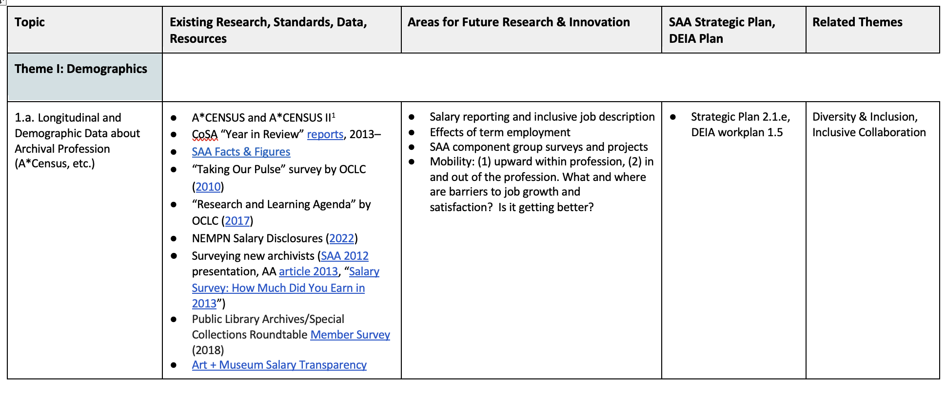
I. Theme: Demographics
Scope: Information about archivists reveals broad trends as well as detailed insight into the profession. Research will enable cross-sectional and longitudinal studies and analysis, and the ability to identify trends over time, as well as surface professional gaps. Insights will strengthen the profession, and will lead to educational, development, training, diversity and inclusion efforts.

Slide 6
II. Theme: Metrics and Institutions
Scope: It is critical that archivists have information and data to support efforts to articulate explicit value propositions for special collections and archives and be able to measure change over time. Business analytics enable research-based practice and practice-based research. The goal is to transition from descriptive data to actionable goals for data through performance measures and service benchmarks. Repository level information will create a baseline for understanding the costs, and resources allocated to the ecosystem of collection formats, as well as use. Benchmarking can also help break down where resources are allocated, along the spectrum and lifecycle of stewardship (donor negotiation, accession, processing, digitization, researcher use, donor stewardship, outreach, etc.)

Slide 7
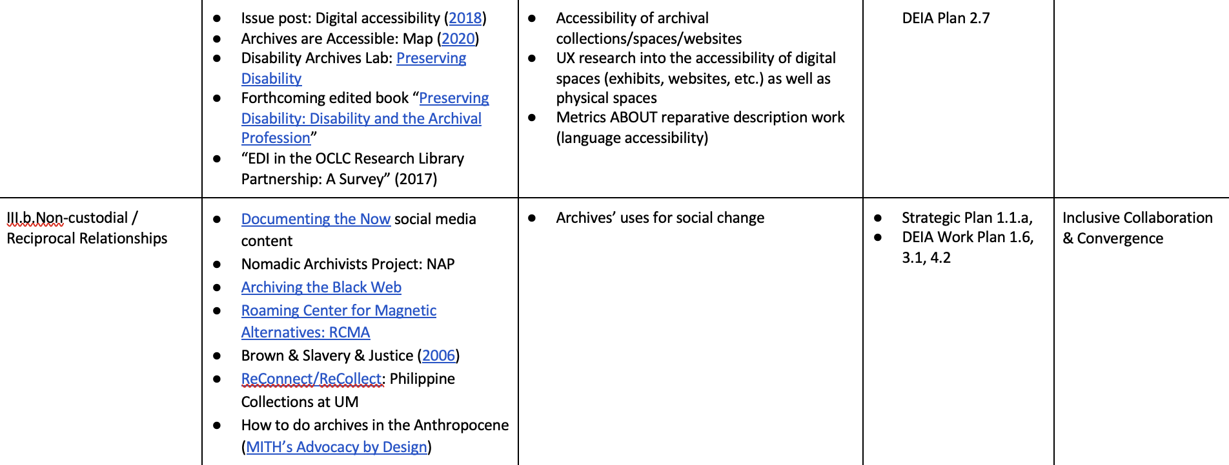
III. Diversity and Inclusion
Scope: Decision makers and influencers must present a diverse and balanced view as programs determine what to collect and how to make collections available. Stories, memories, and patterns of belief are not assets when it comes to leading change within our profession to address systemic racism and oppressive practices. Research informed practice in areas that include recruiting, retention, professional development and mentoring, collections acquisitions and care, access decisions and policies are essential. Diversity of the profession and collections as well as accessibility in the archives and reparative descriptive practices will be strengthened through research into diversity and inclusion.

Slide 8
IV. Ethical Stewardship, Maintenance and Sustainability
Scope: User-centered and data-informed research studies to support public investment in archives’ public services and stewardship. Caring for collections, tracking environmental impact, and justifying an archival activity over another is clearer when there is data to inform decisions and assess the costs and impact of archival activities. What is worth doing over time?

Slide 9
V. Theme: Inclusive Collaboration and Convergence (Radical collaboration)
Scope: Archivists act within broader political and economic systems. Archivists enhance value and impact through collaboration and partnership with allied and complementary organizations and practices. Research in this space will enable archivists to derive evaluative benefit from collaborative efforts. This research focus is in the spirit of the SAA Guidelines for Programs of Academic Study (GPAS) curricular component of “complementary knowledge” to expand research with allied organizations. Collaboration is a research theme.

Slide 10
VI. Theme: Audience Building
Scope: What is the effectiveness of archival efforts to build audiences? What efforts – positions dedicated to outreach or partnerships with journalists and media – best build audiences? Elevating archival awareness and advocacy for archives is advanced through many levels of partnership and funded efforts – at the national, regional, local, institutional level. This research theme seeks to ground practice with research.

Slide 11
VII. User Centered Design and Discovery
Scope: How do users approach, use, find, and use archives? Principles like respect du fond can prejudice the archives to center the records, and the expertise of archivists, in designing systems for archival use and engagement. If we inverted the model to center users, how would we design systems for discovery, access and archival transfer? Research in this area centers users and has the potential to alter current modes of archival practice.

Slide 12
SAA Research & Innovation Roadmap
https://www2.archivists.org/groups/committee-on-research-data-and-assessment/saa-research-and-innovation-roadmap-beta-version-10

Slide 13
Question 1:
What is missing? In your SAA or archival experience, what recurring topics would benefit from research attention? What would be your top 3 additions?

Slide 14
Question 2:
What is here that shouldn’t be?

Slide 15
Question 3:
Is there anything that would make this document more useful to you?

Slide 16
Question 4:
Any feedback on the process of development and proposed next steps?

Slide 17
Thank you!
Please share your feedback through this anonymous Google Form https://forms.gle/QZmG4nmhoFgCsVsJ6
And get in touch with us at: corda@archivists.org
Notes:
We appreciate your attention during this presentation. If you have any questions, please contact us as corda@archivists.org. Thank you!

Slide 18
Committee on Research, Data and Assessment (CORDA)
Dennis Meissner SAA presidential address, “Bare Necessities”
SAA Council charged the Task Force on Research/Data and Evaluation (TF- CORDE)
CORDA launched
SAA Dataverse goes live
Revitalized Facts + Figures site launched
Conclusion of
A*CENSUS II
grant
8/2016
2016
5/2017
11/2018
3/2019
8/2020
2/2021
8/2021
1/2022
8/2022
2023
2024…
President Meissner Proposal for a Committee on Research and Evaluation (CORE)
SAA Council establishes Committee on Research, Data and Assessment
“Demystifying Data Analysis” virtual workshop
“Research Basics for Archivists” webinar
Research and Innovation Roadmap - CONVERSATION LOUNGE
Stay tuned!

